Slide 1

Book Recommendation Chatbot using IBM Watson Assistant
Presented by Ujjval Dubey, United College of Engineering And Research

Slide 2
Declaration and Acknowledgement
I hereby declare that this IBM PBEL Virtual Internship project, "Book Recommendation Chatbot using IBM Watson Assistant," is my original work. All content, design, and implementation efforts are solely attributable to me, developed independently during the internship period.
I extend my sincere gratitude to Mr. R Devnath for his invaluable guidance and mentorship throughout this project. His insights were instrumental in navigating challenges and refining the chatbot's functionality. I also thank the entire IBM PBEL team for providing this enriching virtual internship opportunity and access to the Watson Assistant platform. Finally, I am grateful to United College of Engineering And Research for fostering an environment that encourages practical learning and innovation.

Slide 3
Presentation Roadmap
This presentation will guide you through the development and key aspects of our Book Recommendation Chatbot.
1
Introduction
2
Technologies Involved
Overview of the project and its objectives.
Deep dive into the core technologies used in development.
3
Problem-Solving
4
Output & Demonstration
Challenges encountered and their implemented solutions.
Visual showcase of the chatbot in action.

Slide 4

Project Overview: A Genre-Based Book Recommender
The "Book Recommendation Chatbot" is an intelligent conversational agent developed using IBM Watson Assistant. Its primary purpose is to help users discover books through natural language interaction.
The chatbot focuses on genre-based recommendations, allowing users to specify their preferred literary categories and receive relevant book suggestions. This streamlines the discovery process, making it easier for readers to find new titles tailored to their interests.

Slide 5



Core Technologies: IBM Watson Assistant
At the heart of this project is IBM Watson Assistant, a powerful AI-powered conversational platform. It enables the creation of sophisticated chatbots that understand natural language, interpret user intent, and deliver precise responses.
Natural Language Understanding
Dialog Management
Seamless Integration
The platform provides a visual dialog builder to construct conversational flows, ensuring the chatbot can handle various user queries, maintain context, and provide relevant responses.
Watson Assistant offers easy integration options, including the Watson Web Chat, which allows for quick deployment onto websites with minimal coding, providing an intuitive user experience.
Watson Assistant's NLU capabilities allow it to parse user input, identify intents like "recommend_book," and extract crucial entities such as "@genre" (e.g., fantasy, mystery, sci-fi).

Slide 6




Key Features and Functionality
Genre-Based Recommendations
Intent Recognition
The chatbot's core feature, powered by the @genre entity, allows it to identify specific book genres mentioned by the user and retrieve corresponding recommendations.
It recognizes standard user intents such as greet, recommend_book, and thanks, ensuring a smooth and intuitive conversational flow.
Robust Fallback Handling
Easy Web Integration
For inputs not recognized, a well-defined fallback mechanism ensures the chatbot can gracefully handle unknown queries and redirect users appropriately.
The chatbot can be effortlessly integrated into any website using the Watson Web Chat, providing immediate access to its capabilities without complex backend development.

Slide 7
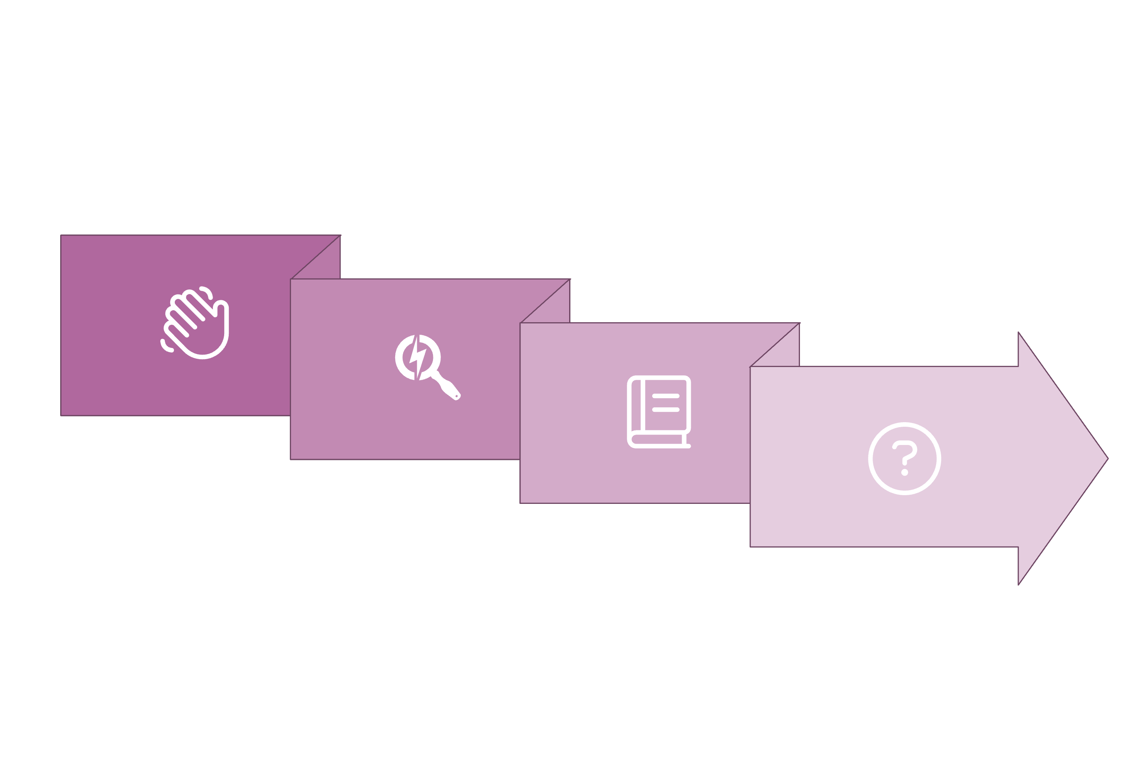




Dialog Flow: User Interaction Pathway
Genre Detection
Fallback Handling
User Greeting
Book Recommendation
The dialog flow is designed to be intuitive and responsive, guiding the user through the book recommendation process efficiently while ensuring that even unforeseen inputs are handled gracefully.

Slide 8
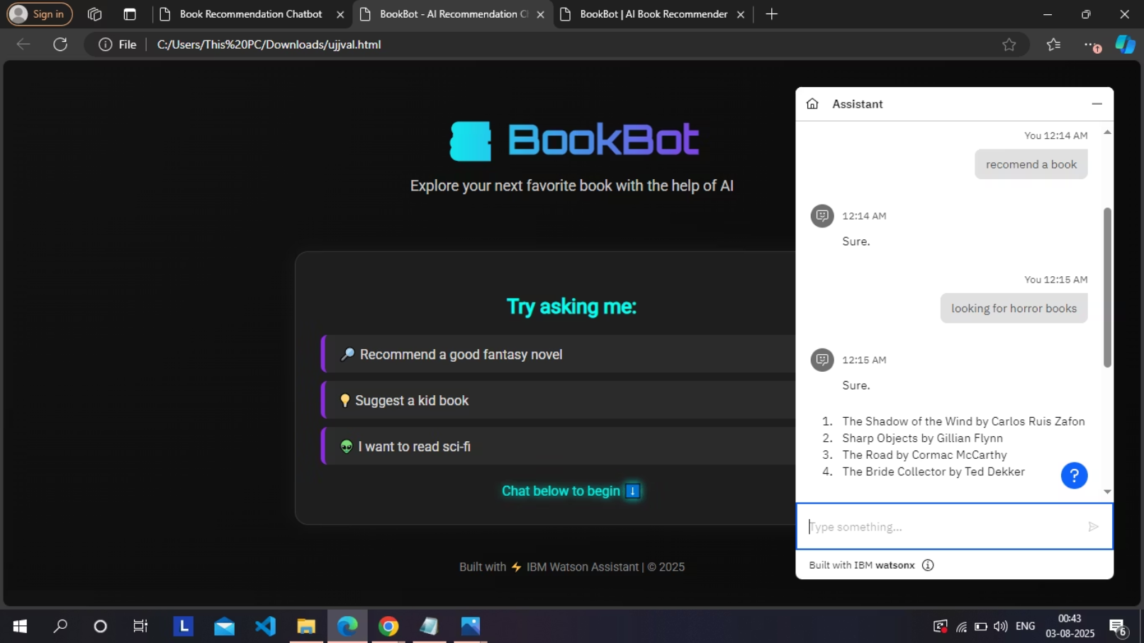
Website Integration: Seamless Deployment
Integrating the IBM Watson Assistant chatbot into a website is achieved with remarkable simplicity, primarily through the use of a single script tag. This approach leverages the powerful Watson Web Chat component.
Once the script is embedded, the chatbot automatically appears in the bottom-right corner of the website, providing immediate access to its functionality without requiring any complex backend development or server-side code. This purely client-side integration makes deployment swift and hassle-free.

Slide 9

Conclusion: A Step Towards Enhanced Book Discovery
The Book Recommendation Chatbot, developed with IBM Watson Assistant, offers a simple yet effective solution for genre-based book discovery. Its ease of deployment and intuitive conversational flow underscore the power of AI in enhancing user experience.
This project demonstrates a clear pathway for leveraging conversational AI to create engaging and helpful tools, marking a significant step in making book discovery more interactive and personalized.
Future Scope:
Expanding recommendation criteria beyond just genre (e.g., author, mood, year).
Integrating with real-time book databases for up-to-date availability.
Adding user preference profiles for more personalized suggestions.
Implementing advanced sentiment analysis for nuanced interactions.

